Slide 1
Hollywood Organic Co-op EDMS Requirements
Your Name:
Course
Date:
Instructor Name:

Slide 2
Summary Statement
The project aims to support Hollywood Organic Co-op organization in ensuring that records of business activities transacted through its new electronic records management systems are appropriately identified and managed by:
improving electronic recordkeeping practices;
reducing the duplication of effort and associated costs in identifying a minimum level of recordkeeping functionality for electronic records management systems;
Establishing greater standardization of recordkeeping requirements for software vendors across different jurisdictions.

Slide 3
Project and Business Objectives Alignment
The aim is to develop an effective electronic records management system and to evaluate available software products against this requirement.
There are three main areas of requirement for the Hollywood Organic Co-op organization:
the ability to build and maintain a file plan structure which all records are classified
the ability to declare an electronic document as a corporate record, and to maintain its integrity.
the ability to consistently manage the retention and disposition of folders of electronic records.

Slide 4
Document Access Controls and Best Practices.
Provide consistent and predictable structuring principles for the electronic fileplan.
Support the open and closed electronic parts, as subsidiary and discrete sub-groupings within an electronic folder, delimited according to rules specified at installation.
Retrieve electronic records by search of record metadata, and electronic folders or groups of folders by search of folder metadata; and enable navigation through the folder structure (Laudon & Laudon, 2016).

Slide 5
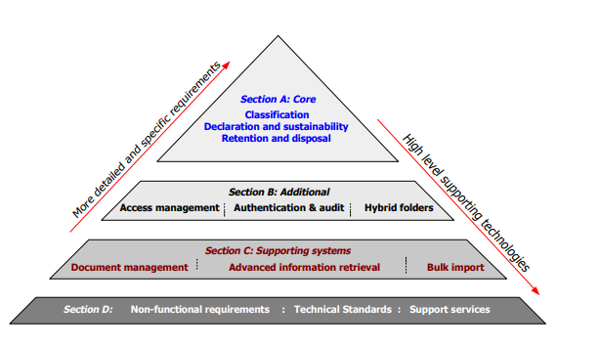
Structure of the Requirements

Slide 6
Document Preservation
Archiving and preservation
  Challenges:
    Digital information is fragile and can be corrupted or altered;
    It may become unusable as storage technologies change.
  Metadata is key to ensuring that resources will survive and continue to be accessible into the future. Archiving and preservation require special elements:
    to track the lineage of a digital object,
    to detail its physical characteristics, and
    to document its behavior in order to emulate it in future technologies.

Slide 7
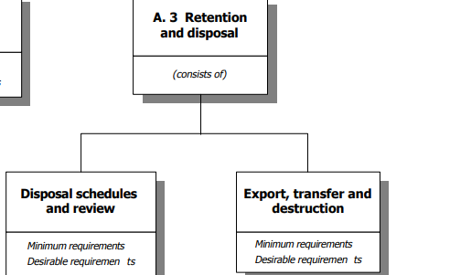
Data Retention

Slide 8
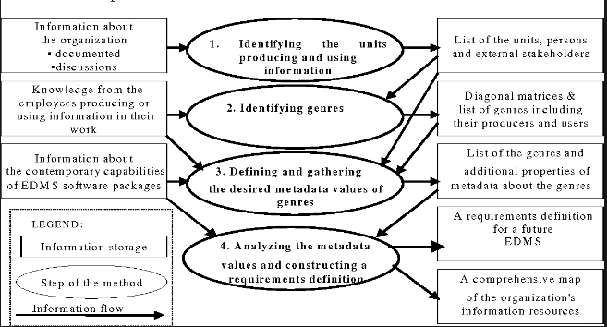
Document Processing

Slide 9
Data Protection
The EDMS should support reporting and analysis tools for the management of retention and disposal schedules by the records manager, including the ability to:
notify all disposal schedules which will come into force in a given period of time, and provide quantitative reports on electronic folder size and electronic record types
notify statistics of review decisions in a given period
identify, compare and review disposal schedules across the electronic fileplan
identify formal contradictions in retention and disposition across the electronic fileplan.

Slide 10
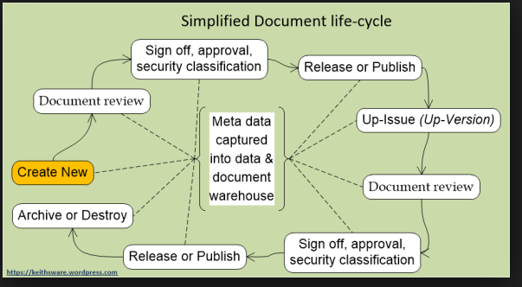
Document Lifecycle

Slide 11
Document Lifecycle
  Writing documents
  Review of draft documents
  Approval of draft documents resulting in controlled documents
  Access and use of controlled documents
  Periodic review of controlled documents
  Revision of controlled documents, if necessary
  Retirement of controlled documents
  Archival of controlled documents

Slide 12
Security & Audit Trails
Document access configured by employee role or department puts information in the right hands. Audit trails automatically track exactly how information is being accessed for on-going regulatory compliance.
EDMS will contain the ability to modify documents for streamlined collaboration.
Annotations, redaction options for sensitive information, highlight tools, stamps, text boxes and other markup tools provide searchable context and decision points around the content contained in files.

Slide 13
References
Larin, M., & Мukhatova, О. (2019). FUNCTIONAL REQUIREMENTS FOR INFORMATION SYSTEMS ELECTRONIC DOCUMENT CIRCULATION. Вестник КазНУ. Серия историческая, 92(1), 55-61.
Laudon, K. C., & Laudon, J. P. (2016). Management information system. Pearson Education India.
Singh, A. K. (2015). Electronic Document Management System and Services. Library Waves-A Biannual Peer Reviewed Journal, 1(2), 130-133.
Partinen, S. (2019). Machine learning as document metadata tool in e-business services.

